Slide 1
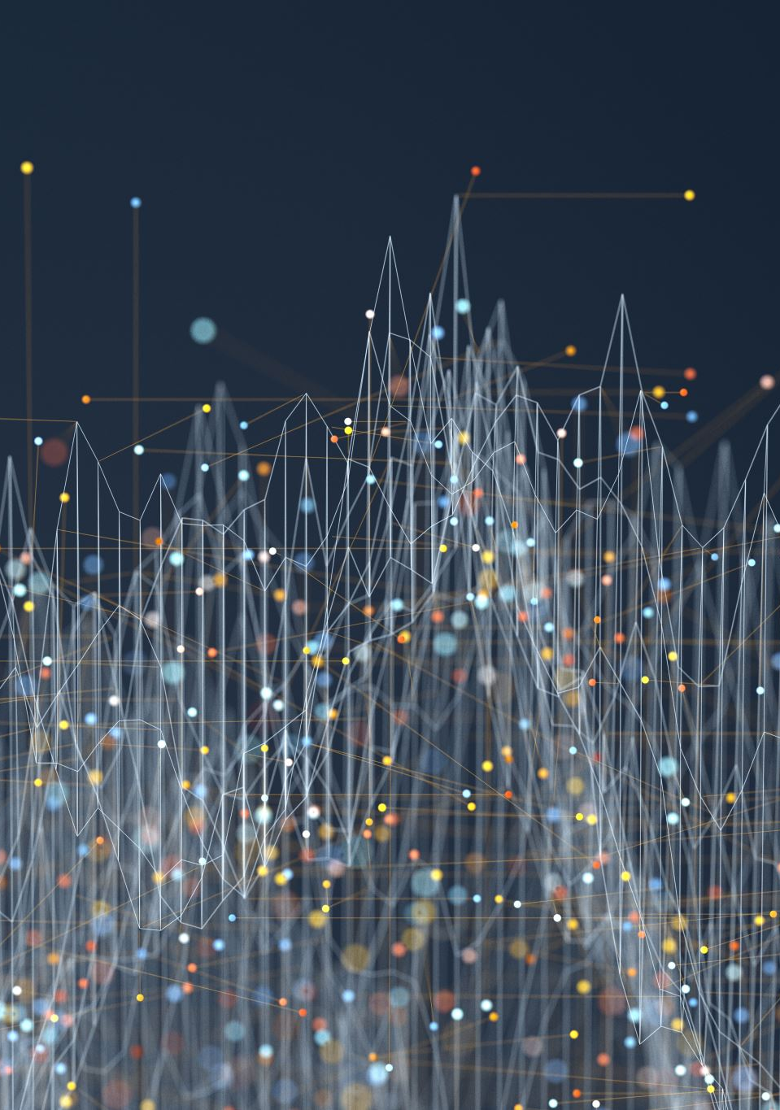

DSO528 Blended Data Business Analytics for Efficient Decisions
Clustering Intro
Feng Chen

Slide 2
Learning Objectives
Articulate the difference between supervised learning and unsupervised learning.
Identify the opportunities to apply clustering.
Apply K-means model to build clusters for a small data set.
Interpret the main features of a cluster and find the difference between clusters.
Make business recommendation based on the clusters formed.

Slide 3
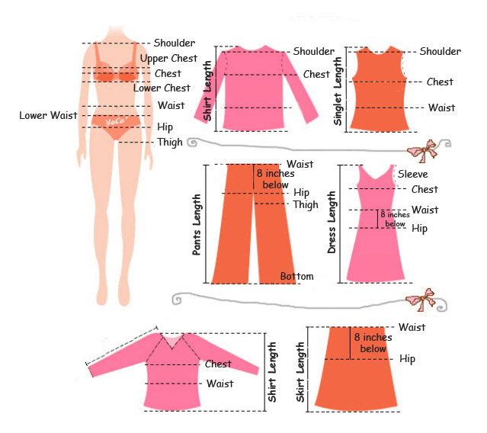
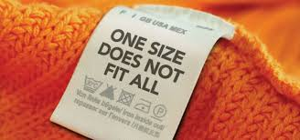
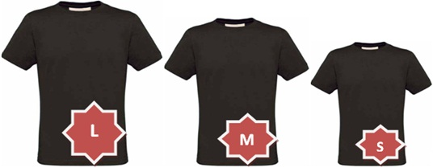
Recalled the following methods…
Linear regression
KPI/Dashboarding
Hypothesis Testing
Linear optimization (linear programming)
Classification (Decision Tree or Logistic Regression)
Given the following business scenario, which of the above you think would be most helpful in guiding decision making.
In clothing product design: How big should a “medium” be?

Slide 4
Today
What is clustering and how can it be used in business analytics?
Overview of clustering method
K-means clustering with Netflix data

Slide 5
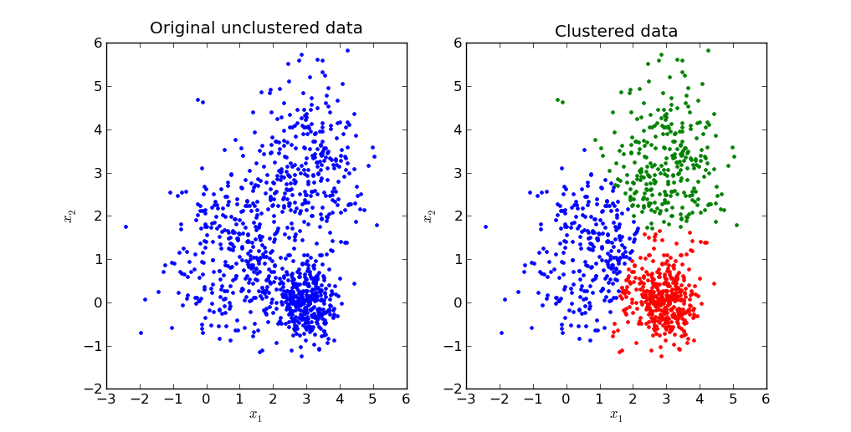
What is clustering?
Takes a (large) number of distinct items and groups them into a (small) number of similar groups or “clusters”
Items in the same cluster are very similar to one another
Items in different cluster are different from one another

Slide 6
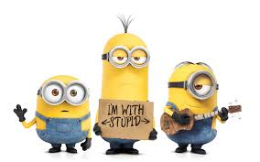
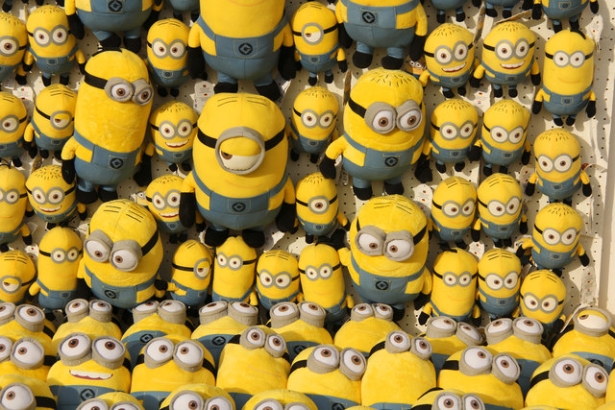
Ex: Market segmentation
Difficult to understand the individual needs of all of your customers
Group your customers into a small number of clusters with similar needs/ behavior
How might this clustering help you as a business?
You will do this sort of analysis in the coming case!

Slide 7
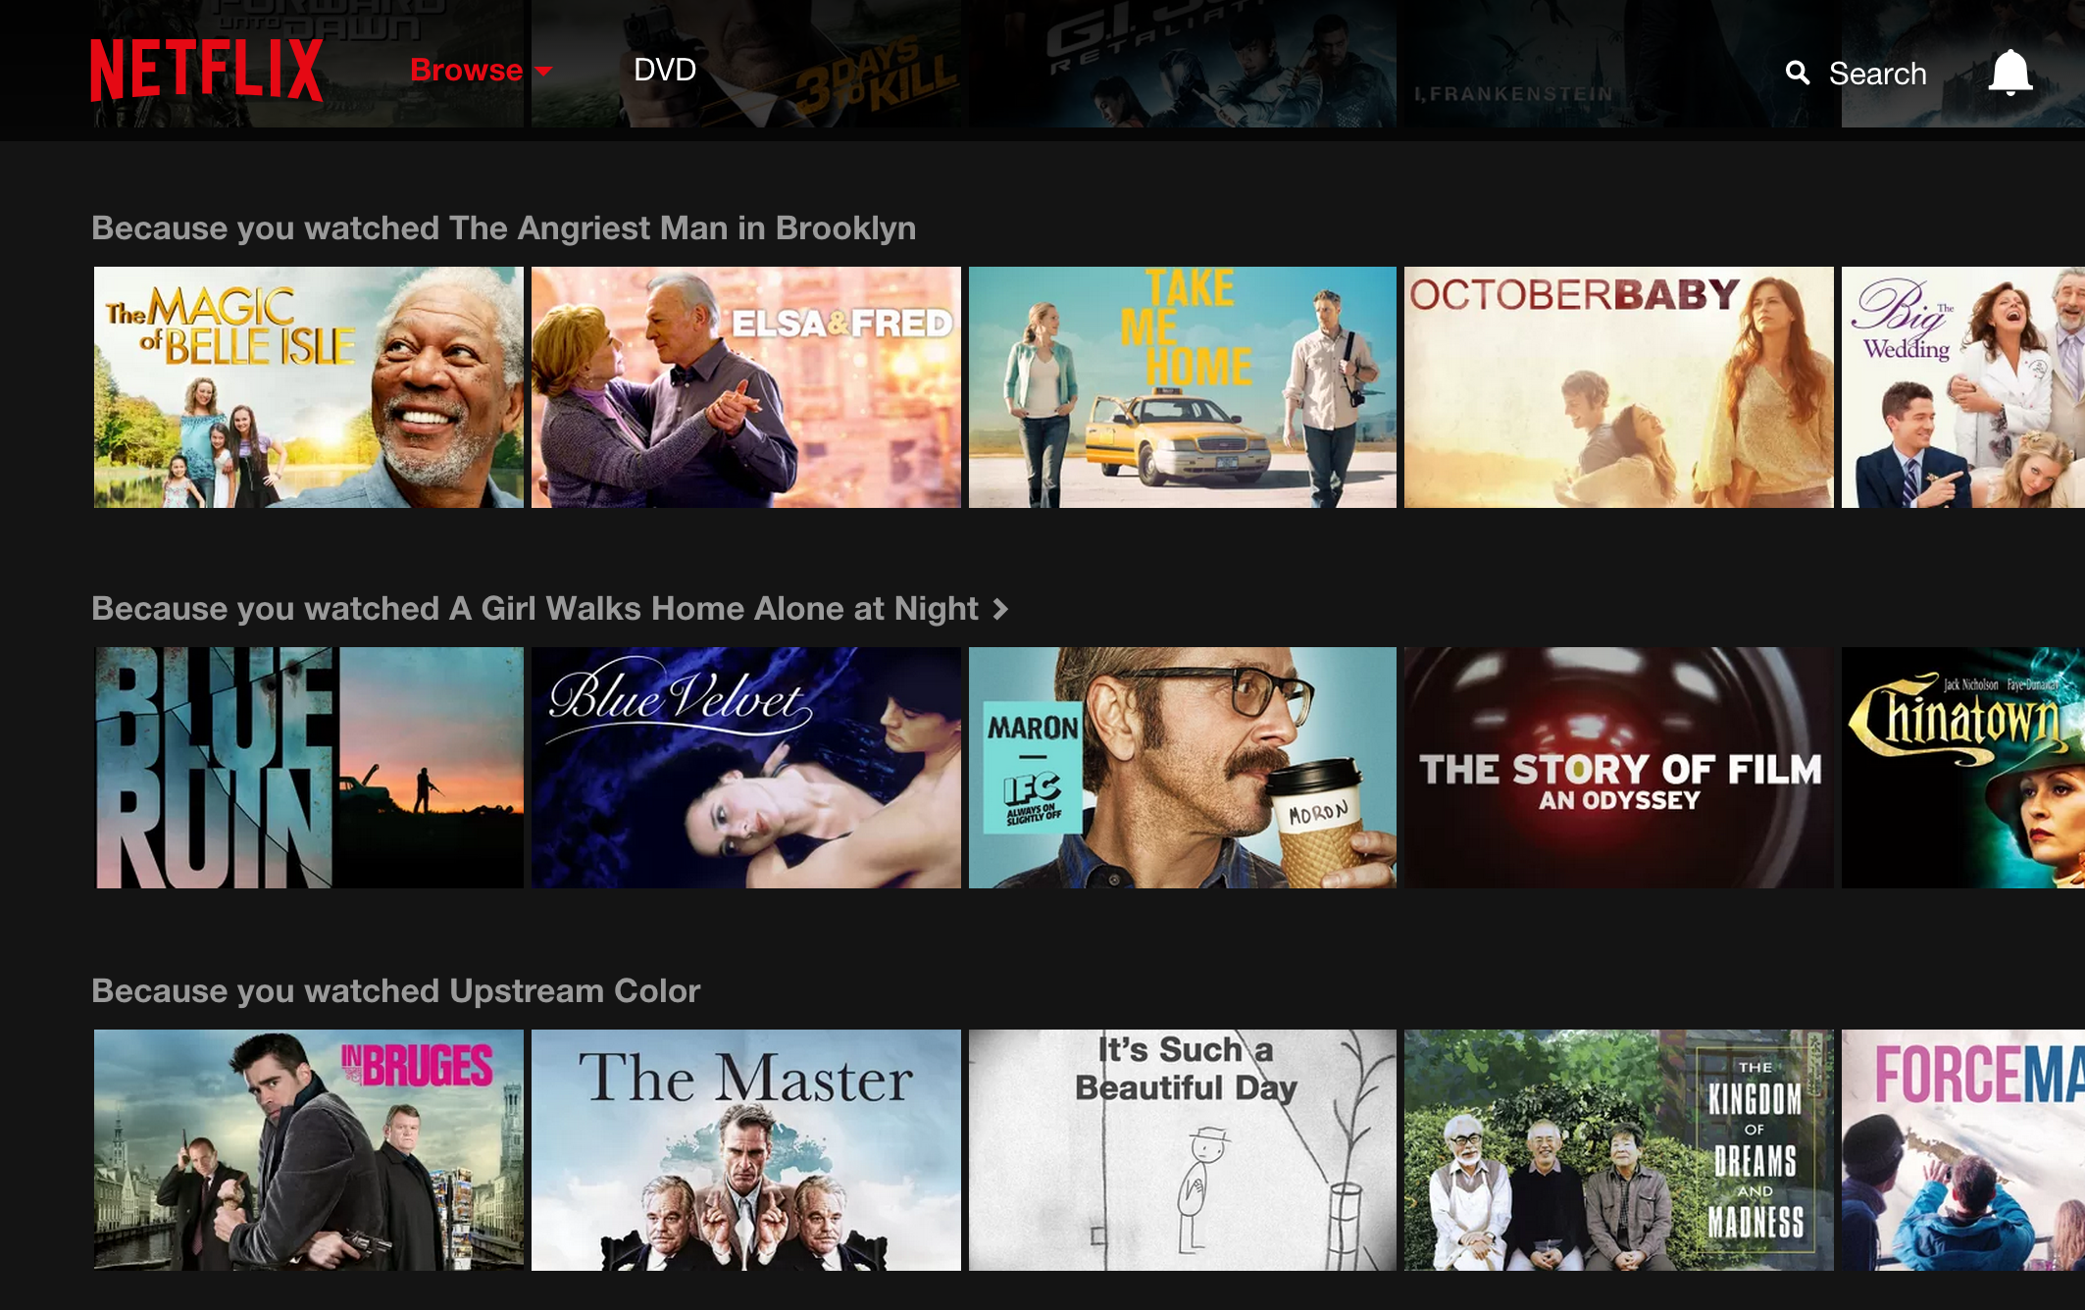
Ex. Recommendation engines
Do you find the recommendation engine helpful?
What is the value of this engine to Netflix?
Can you think of a way to quantify the value of this engine?
How might we improve the value of this engine?

Slide 8
What do we mean by “similar”? (Intuitively)
Each item (data point) has a number features that we’ve measured
Each “row” has many columns
Ex: Clustering customer’s spending by dept at Amazon.
Each item is a customer. Each dept is a column.
For each customer, we have the $ amt spent in that dept. (Features)
We say two items are similar if they have similar features
Two customers are similar if they spent similar amounts of money in each department

Slide 9
Why do we want to cluster?
Simplification
Easier to think about 3 prototypical types than 150 different items
Identify hidden structure
Do the 3 groups behave differently?
What are the main difference among these groups?
Key idea: we want an automated way to do this from data

Slide 10
Overview of clustering method

Slide 11
Classification vs. Clustering
Classification
Clustering
Independent dependent variables
Number of classes known
Well-defined notion of accuracy
Predictive
Independent variables only
Number of clusters unknown
No notion of “accuracy”
X
Y
X
Supervised
Unsupervised

Slide 12
The basic steps involved in cluster analysis:
Formulate the problem Select the attributes(variables) that you wish to use as the basis for similarity measurement. Or the “by what” attributes the similarity measure.
Apply the clustering procedure. (Kmeans for this course)
Decide on the number of clusters.
Map and interpret clusters—
Draw conclusions
Illustrative techniques like Graphs are useful.
How to apply the clusters result varies from one case to another. It heavily depends on the business context.

Slide 13

Case study: clustering movies
Subset of data from movielens.org
Open “movies.csv” from Brightspace
Each movie in the database is categorized as belonging to 19 different genres
Action, Comedy, Adventure, Thriller, War, etc.
A movie might belong to multiple genres
Value 1 indicates that the movie belongs to the genre and 0 otherwise

Slide 14
Measuring the right features
Of course, there is a ton of other publicly available data about movies
We could add lots of different features to cluster upon
Do you think including the following features will improve our clustering?
Number of letters in the title
% of people surveyed that liked the movie?
Current Rotten Tomatoes rating?
How many stars the user gave it on Netflix
Name of the director?

Slide 15
Measuring the right features (continued)
Good features
Intuitively correlate with the genres
Are numeric
Are cheap to measure/obtain
Are likely to be stable
Are USEFUL for the business application
Finding good features is usually the most important task in a clustering application
We will use the genre labels and the year released only

Slide 16
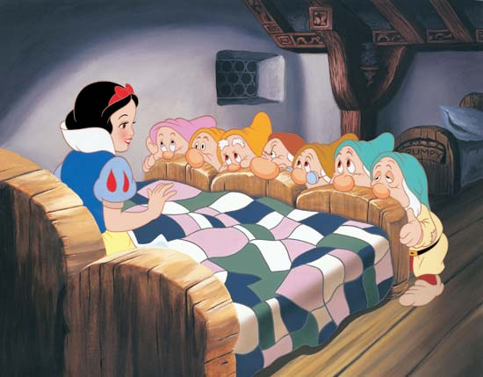
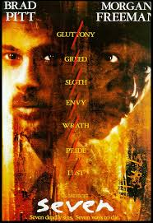
How do we define most “similar”?
For two data points, we can compute the distance between them
Closer points are more similar
Which is more similar to Toy Story? Snow White and Seven Dwarfs or Seven?
Toy Story | 0 | 0 | 1 | 1 | 1 | 0 | 0 | 0 | 0 | 0
Seven | 0 | 0 | 0 | 0 | 0 | 0 | 0 | 0 | 0 | 1
Snow White | 0 | 0 | 1 | 1 | 0 | 0 | 0 | 0 | 0 | 0

Slide 17
Including year
Suppose we use “Year released” as a feature in our clustering
Which is closer to Toy Story (1995)? Snow White (1937) or Seven (1995)?

Slide 18
Standardizing features
If one feature takes values which are typically much larger than the others, it dominates the distance computation
We lose all information in the other features.
Better to standardize each feature first
Subtract the mean of the column from all entries, divide by standard dev.
Most software packages have function for this.
You should almost always standardize features before clustering unless you have a very good reason not to

Slide 19
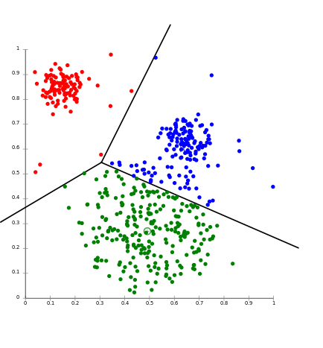
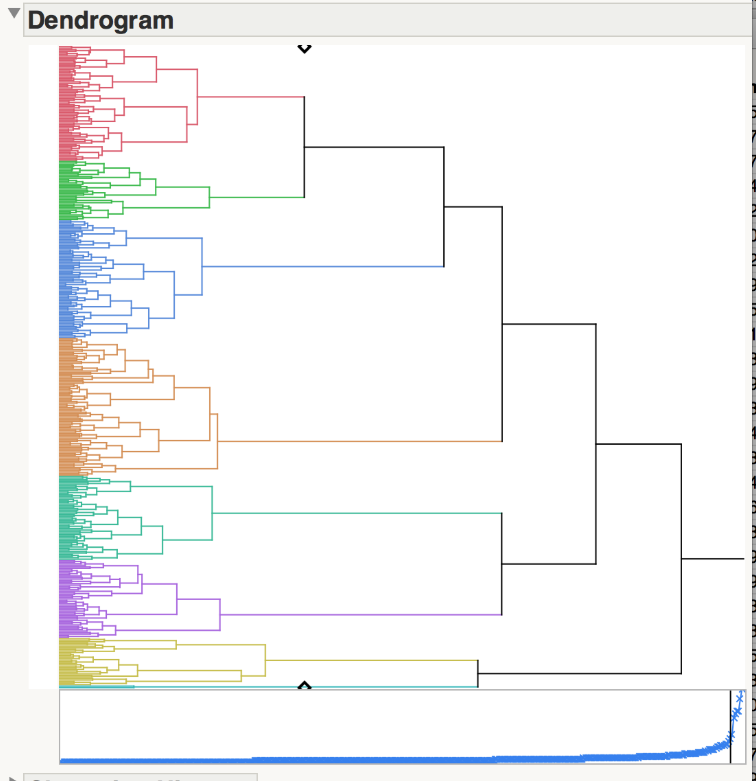
Techniques
There are many types of clustering algorithms
Each algorithm also has different variants/toggles
Below are two common methods. We will focus on K-Means.
Hierarchical Clustering
K-Means Clustering

Slide 20
K-means clustering
Many similarities to hierarchical clustering
Uses distance between the features of different points to define similarity
Same comments from last time about picking the right features and standardizing apply
Unlike hierarchical clustering, method based upon distances to centroids
A centroid is the average (mean) value of all the data points in a cluster
Hence the name, k-means

Slide 21
Key idea
Pick the number of clusters (k) up front (say 5)
Algorithm initialized and k cluster centroids are randomly selected.
Assign each point to its nearest centroid
Centroids and data points will be updated multiple times till clusters are finalized.
Centroids are like “prototypical” members
Study them to build intuition about the cluster
Distance from centroid to understand outliers

Slide 22
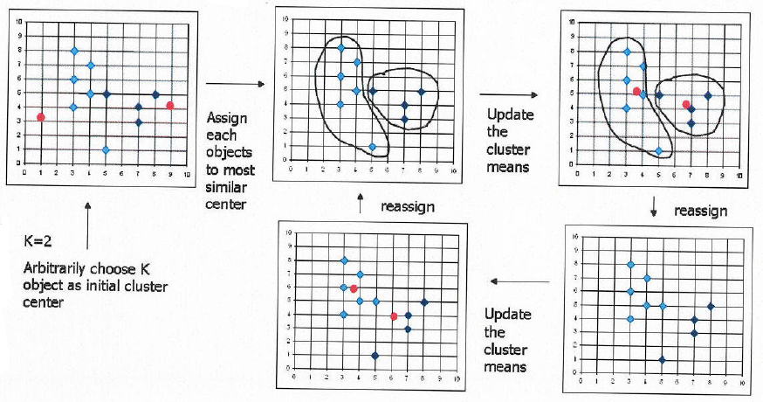
Visual Representation of K-Mean Clustering

Slide 23
Finding the “best” centroids
Finding the centroids that minimize total sum of square loss is actually a challenging mathematical problem
K means uses an iterative algorithm
Guess at some centroids
Assign all the points
Recompute the centroids
Go to Step 2 until the centroids don’t move anymore.
http://alekseynp.com/viz/k-means.html
https://datasciencelab.wordpress.com/2013/12/12/clustering-with-k-means-in-python/

Slide 24

Wrapping up
Articulate the difference between supervised learning and unsupervised learning.
Identify the opportunities to apply clustering.
Apply K-means model to build clusters for a small data set.
Interpret the main features of a cluster and find the difference between clusters.
Make business recommendation based on the clusters formed.

